Slide 1

Monsoon Going… Leaves May Fall but Let Trees Rise – Green Bengaluru Together!
🌧 Natural water supply supports healthy root growth
🌱 Higher plant survival rate
❄️ Cooler weather reduces transplant shock
🌿 Less irrigation needed during early stages
bengaluru_lakes_hills

Slide 2
Lifespan:
bengaluru_lakes_hills

Slide 3
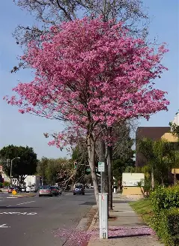
Singapore Cherry
Fast-growing, birds love fruits, Excellent for urban biodiversity
Lifespan: 15–25 years
Small Tree ~ 5 ft radius
Plant in loose, well-drained soil
bengaluru_lakes_hills

Slide 4
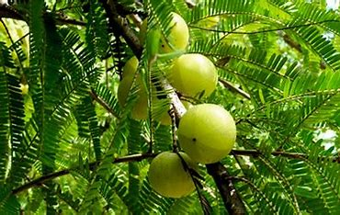
Amla (Indian Gooseberry)
Edible fruit, medicinal, vitamin C rich, Excellent for air purification & health
Lifespan: 40–60 years
~6 ft radius space Req.
Plant grafted sapling in well-drained soil; water regularly in 1st month
bengaluru_lakes_hills

Slide 5
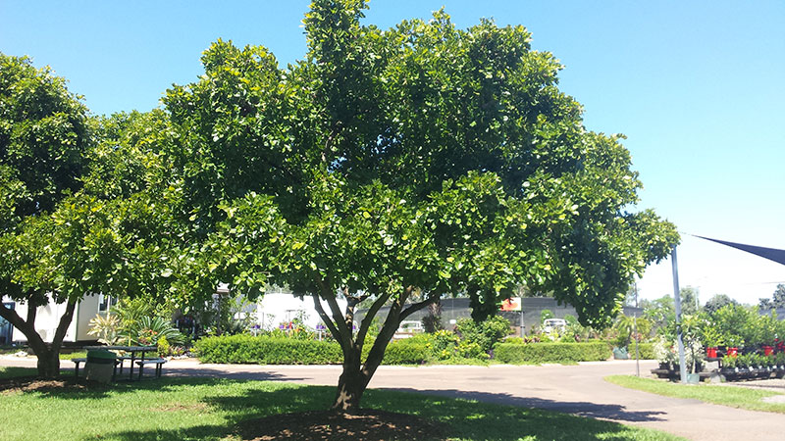
Indian Beech (Honge)
Native tree, Needs ~5–6 ft radius
Nitrogen fixer, pollution resistant, Strong oxygen release, soil enrichment
Lifespan : 30–50 years
Plant sapling in 2 ft pit with compost; water moderately
bengaluru_lakes_hills

Slide 6
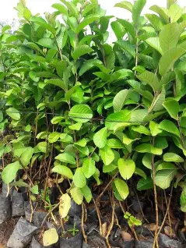
Guava
Nutritious fruit, Moderate oxygen release, improves air quality
Area Req: ~6–8 ft radius, Lifespan: 25–40 years
Plant in sunny spot, use compost-rich soil
bengaluru_lakes_hills

Slide 7
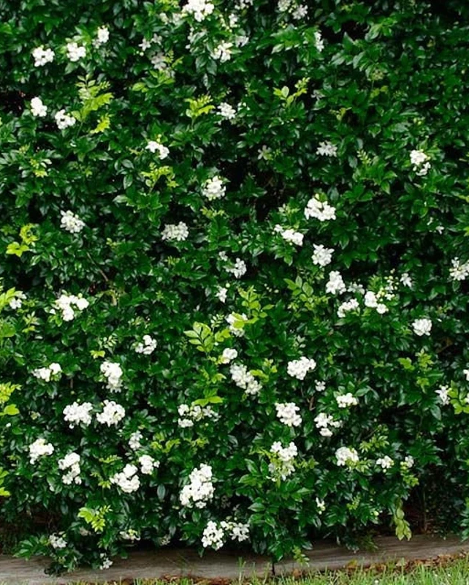
Jasmine (Jasminum)
Aromatic flowers, ritual use, Moderate oxygen release, stress-reducing aroma
Lifespan: 8-10 years, Requires Space ~2 ft radius
Plant near fence or pot; well-draining soil, water regularly
bengaluru_lakes_hills

